Slide 1
Embrace Diversity, Equity, and Inclusion - Building Bridges to a Stronger Community
Presented by Keena Thaxton CDP®

Slide 2
Agenda
01
Diversity, Equity, and Inclusion | The Difference
02
Build your BRIDGE to a Stronger Community
03
Effective Community Engagement
04
Community Involvement | Business Impact
05
Q&A

Slide 3
Diversity, Equity, and Inclusion | The Difference
Diversity
Equity
Inclusion
Representation that encompasses the perspectives, unique qualities, and values of everyone. Including but not limited to- ethnicity, national origin, language, gender, race, sexual orientation, physical appearance, education, professional background, socioeconomic status, age, lived experience, abilities, religious beliefs. It is about recognizing and appreciating the value that different cultures offer.
The fair treatment, access, opportunity, and advancement of all people, while at the same time striving to identify and eliminate barriers that prevent the full participation of some groups. The principle of equity acknowledges that there are historically underserved and underrepresented populations and that fairness regarding these unbalanced conditions is necessary to provide equal opportunity for all.
The act of creating an environment in which any individual or group will be welcomed, respected,
supported and valued as a fully integrated member. An inclusive and welcoming climate embraces and respects differences.

Slide 4
Build your BRIDGE to a Stronger Community
1
Define your goals & Establish DEI Taskforce
2
Identify your target audience & Conduct a Community Needs Assessment
3
Choose a Cause & Collaborate with local organizations
4
Volunteer & offer expertise & Engage Schools and Educational Institutions.
5
Sponsor local events & Celebrate Diversity & Cultural Exchange
5
Sponsor local events & Celebrate Diversity & Cultural Exchange
6
Measure & Evaluate the impact

Slide 5
Community Outreach Strategy Framework
Define Goals & Establish DEI taskforce
Conduct a Community Needs Assessment
Celebrate Diversity & Cultural Exchange
Goals
Build positive brand reputation
Host focus group & identify DEI challenges
Sponsor (2) local events focused on food poverty
KPI
DEI taskforce will be the driving force for all DEI initiatives
Understand the demographics and interests of the target audience
Host (2) cultural awareness events onsite
Key Enablers
Leadership
DEI Taskforce
DEI Taskforce
Diverse stakeholders
Local Community
Local Community organization
DEI subject matter expert
Create culturally sensitive survey
Social Media& Email Campaign

Slide 6
Community Outreach Strategy | Implementation Plan
Objectives
Challenges
Strategies
Channels
Owner/PoC
Don’t have a DEI SME
Connect with local organization that can be the SME
Email
Define Goals & Establish DEI taskforce
X Leaders name
Role/Position
Lack of unconscious bias awareness
LinkedIn learning to gain unconscious bias training
Bi-weekly meetings.

Slide 7
Effective Community Engagement
Establish partnerships with local organizations and groups that specialize in DEI initiatives to collaborate on community outreach efforts.
Attend local community events
Foster Open Communication
Build Relationships & partnership
Offer educational opportunities
Collaborate on projects
Support local initiatives
Engage employees
Be responsive & responsible
Celebrate achievements
Measure Impact

Slide 8
Community Involvement | Business Impact
01
Highly trusted companies outperform others by 400% in market value
02
95% of employees who work for purpose-driven companies report that they are more loyal
03
80% reported that community involvement improve the ability to recruit employees
04
44% of business owners have grown as a result of engaging in the community
Sources:
Research: Consumers’ Sustainability Demands Are Rising (hbr.org)
deloitte-2020-millennial-survey.pdf

Slide 9
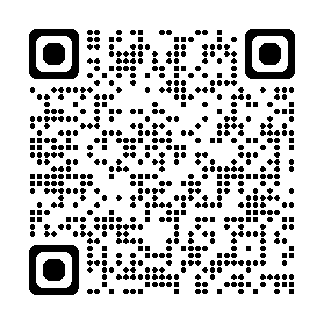
THANK YOU
Stay in touch!
Chicago, IL
Keena.Thaxton@amfam.com
(708) 990-2636

